Slide 1
CAPSTONE PROJECT
HOTEL BOOKING ANALYSIS
Presented By:
Sreenidhi V –Anna University(ACT campus) –Department of Biotechnology(Pharmaceutical Technology)

Slide 2
OUTLINE
Problem Statement
Proposed System/Solution
System Development Approach
Algorithm & Deployment
Result
Conclusion
Future Scope
References

Slide 3
PROBLEM STATEMENT
Have you ever wondered when the best time of year to book a hotel room is? Or the optimal length of stay in order to get the best daily rate? What if you wanted to predict whether or not a hotel was likely to receive a disproportionately high number of special requests? This hotel booking dataset can help you explore those questions! This data set contains booking information for a city hotel and a resort hotel, and includes information such as when the booking was made, length of stay, the number of adults, children, and/or babies, and the number of available parking spaces, among other things. All personally identifying information has been removed from the data. Explore and analyse the data to discover important factors that govern the bookings.

Slide 4
PROPOSED SOLUTION
In our solution, we harness advanced machine learning techniques to derive insights from extensive hotel booking data, focusing on:
Pattern Recognition: Analyzing historical data to identify trends and correlations in hotel bookings.
Predictive Timing: Utilizing predictive models to recommend optimal booking times based on seasonality, demand fluctuations, and promotional periods.
Optimal Length of Stay: Determining ideal stay durations through data-driven analysis, incorporating day-of-week trends and pricing strategies.
Special Request Prediction: Employing specialized models to forecast elevated special requests by studying guest profiles, reservation details, and hotel amenities.
Our holistic approach empowers both travelers and hoteliers with actionable intelligence for strategic decision-making in the dynamic hospitality industry.

Slide 5
SYSTEM APPROACH
Building the proposed solution would involve a combination of data processing, feature engineering, and machine learning. Here are the key system and library requirements:
System Requirements:
Hardware:
- A computer with sufficient processing power, preferably with multiple cores or a GPU for faster training of machine learning models.
-Adequate RAM to handle the size of the dataset and computational requirements.
2. Software:
- An operating system compatible with the required machine learning libraries (e.g., Windows, Linux, macOS).

Slide 6
SYSTEM APPROACH
Library Requirements:
Data Processing and Analysis:
- Pandas: For data manipulation and analysis.
- NumPy: For numerical operations on data.
2. Data Visualization:
- Matplotlib and Seaborn: For creating visualizations to understand data patterns.
- Plotly or Bokeh: Interactive visualization libraries for more complex visualizations.

Slide 7
ALGORITHM & DEPLOYMENT
Algorithm Selection
Data Exploration:
Explore the hotel_booking dataset's structure, features, and target variable(s).
Identify potential patterns, correlations, and outliers.
Problem Formulation:
Define the problem: Predict optimal booking times, ideal length of stay, and likelihood of special requests based on historical data.
Algorithm Selection:
Regression tasks (e.g., predicting daily rates)
Consider linear regression, decision trees, or ensemble methods (XGBoost, LightGBM)
Classification tasks (e.g., predicting special requests)
Consider logistic regression, decision trees, or random forests.

Slide 8
ALGORITHM & DEPLOYMENT
Data Input:
Data Collection:
Gather historical hotel booking datą, including information on booking dates, length of stay, special requests, guest profiles, and relevant hotel details.
Data Cleaning:
Handle missing values, outliers, and any inconsistencies in the dataset.
Convert categorical variables into numerical representations through encoding techniques.
Feature Engineering:
Create new features or modify existing ones based on domain knowledge.
Extract meaningful information from date variables, such as day-of-week or month.

Slide 9
ALGORITHM & DEPLOYMENT
Training Process:
Data Splitting:
Divide the dataset into training and testing sets to evaluate the model's performance.
Feature Scaling:
Standardize or normalize numerical features to ensure they have a consistent scale.
Model Training:
Use the selected algorithm to train the model on the training dataset.
Adjust hyperparameters to optimize model performance.
Model Evaluation:
Evaluate the model on the testing dataset using appropriate metrics (e.g.. Mean Squared Error for regression, accuracy, precision, recall for classification).Fine-tune the model if necessary.

Slide 10
ALGORITHM & DEPLOYMENT
Prediction Process:
New Data Input:
Collect new data or use existing data to make predictions.
Preprocessing:
Apply the same data preprocessing steps (cleaning, feature engineering, scaling) to the new data.
Model Inference:
Use the trained model to make predictions on the new data.
Results Interpretation:
Interpret the model's predictions in the context of the problem at hand.
For regression, interpret the predicted values as optimal rates or lengths of stay. For classification, interpret predictions as the likelihood of special requests.

Slide 11
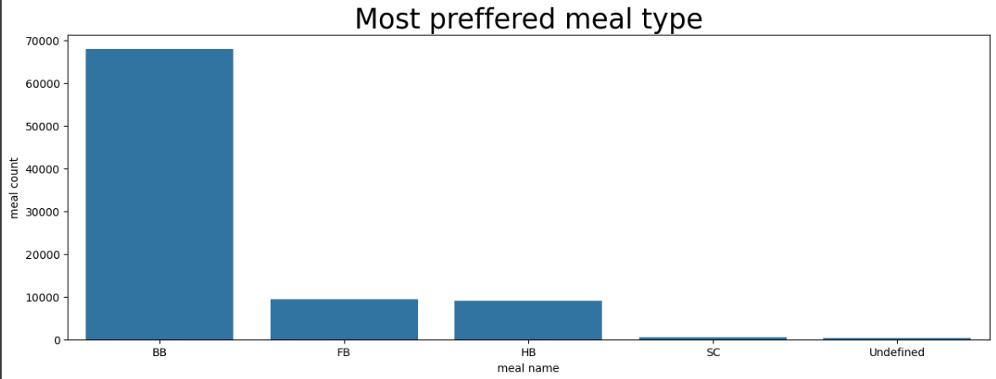
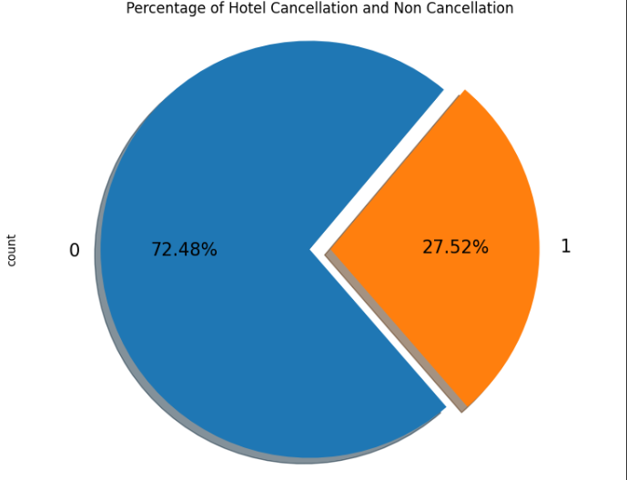
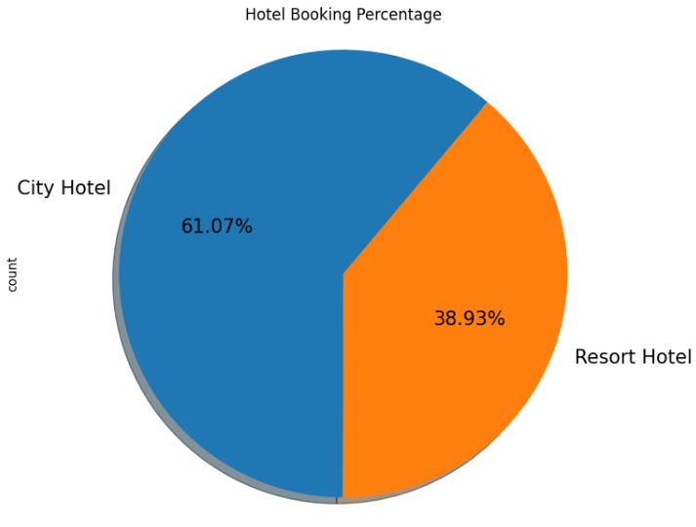
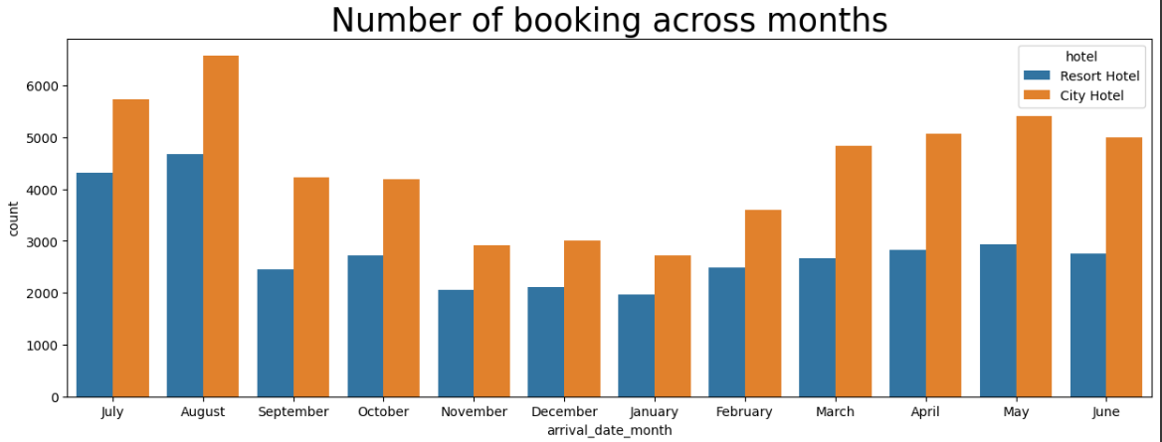
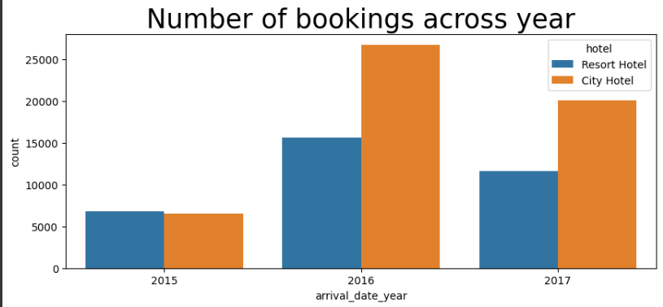
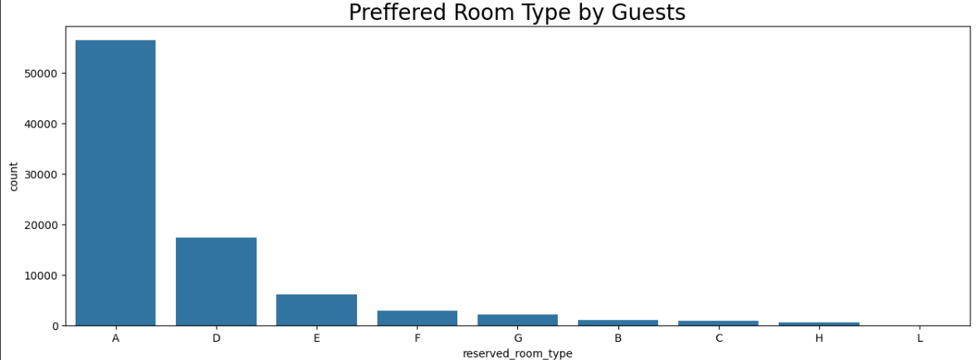
RESULT

Slide 12
CONCLUSION
In conclusion, our proposed solution harnesses the power of advanced machine learning algorithms to transform the hotel reservation process into a dynamic and optimized experience. By meticulously analyzing extensive historical booking data, we unlock patterns and correlations that are pivotal in addressing key challenges faced by both travelers and hoteliers.

Slide 13
FUTURE SCOPE
The proposed solution lays the foundation for ongoing advancements in the realm of hotel reservation optimization. Here are key areas for future exploration and enhancement:
Real-time Predictions: Move towards real-time predictive models that account for instant changes in demand, external events, and other dynamic factors to provide users with up-to-the-minute insights for booking decisions.
Personalization and Customization: Enhance the predictive models to offer more personalized recommendations by considering individual guest preferences, loyalty history, and user-specific requirements, providing a tailored experience for each traveler.

Slide 14
REFERENCES
https://www.kaggle.com/datasets
https://pandas.pydata.org/pandasdocs/stable/userguide/index.html
https://seaborn.pydata.org/
https://matplotlib.org/stable/contents.html

Slide 15
THANK YOU

